Slide 1
Introduction and Objective
14 in 4 intro
Advise, Move, Build, Manage
IBM Services for Cloud
1

Slide 2
Mapping to client scenario
Client Scenarios
Solution Architecture
Delivery Framework
Testing Strategy
Sizing & Estimation
Delivery Model
Risk Reviews
Pricing Options
Integration with other offerings
Client Scenario | Solution | Driver | Capabilities | Business Results
I need to rapidly bring an innovative idea to market | Minimum Viable Product using Cloud Native Capabilities | Rapid Proof of Concept Creation Rapid time to Market Low costs through cloud leverage Ideate, Innovate, Implement | Design Thinking API Microservices Cloud Application Architecture Internet of Things* BigData* Artificial Intelligence* Machine learning* | Design Thinking enabled idea development & minimum viable product definition Rapid Delivery of PoC & MVP using Platform as a Service & Garage Method Practices
I have built an MVP; need to deploy it in large-scale with full functional scope | Cloud Native Application Development @ Enterprise Scale | Deliver cloud native applications with full functional scope Additional rigor for availability, disaster recovery, security & data privacy | Cloud Application Architecture API Microservices Hybrid Cloud Integration Agile Program Management & Governance Internet of Things* BigData* Artificial Intelligence* Machine learning* | Production Delivery with Compliance Hybrid Cloud Platform Leverage (IBM / Non-IBM)
I need to re-write an existing application using new architecture and cloud native capabilities I need to apply Cloud Native Transformation at Enterprise Scale to IT Landscape | Cloud Native Transformation @ Enterprise Scale | Application Re-write to support User Experience, Future Proofing AND/OR new revenue channels Assisted Transformation of Enterprise for cloud native development | Cloud Application Architecture Hybrid Cloud Integration API Microservices Agile Program Management & Governance Internet of Things* BigData* Artificial Intelligence* Machine learning* | Large Scale Cloud Adoption Enterprise Transformation New Operating Model
IBM Services for Cloud
2

Slide 3
Mapping to client scenario Contd.
Client Scenarios
Solution Architecture
Delivery Framework
Testing Strategy
Sizing & Estimation
Delivery Model
Risk Reviews
Pricing Options
Integration with other offerings
Client Scenario | Solution | Driver | Capabilities | Business Results
I need to modernize my Integration portfolio | Modernize traditional integration solutions using combination of API-fication and cloud native applications | Changes to Coarse grained services with high degree of reuse require longer cycles due to additional regression testing, approval from multiple teams etc. Cost optimization initiatives require use of open source technologies Need to support real-time transactions, event based architecture needs that newer business models demand | Cloud Application Architecture Hybrid Cloud Integration API Microservices Agile Program Management & Governance | Nimble Microservices based on bounded contexts support business agility and time to market Cloud native components support scalability, resiliency
I need to rationalize and modernize my data landscape* | Modernize temporal data stores into organized repositories using Data Lakes, Data Marts and Insights available through APIs | Maintenance Cost due to proliferation and lack of agility Need to leverage newer technologies to meet business needs | BigData* Artificial Intelligence* Machine learning*
IBM Services for Cloud
3

Slide 4
Solution Architecture
Client Scenarios
Solution Architecture
Delivery Framework
Testing Strategy
Sizing & Estimation
Delivery Model
Risk Reviews
Pricing Options
Integration with other offerings
IBM Services for Cloud
4

Slide 5
Solution Architecture
Client Scenarios
Solution Architecture
Delivery Framework
Testing Strategy
Sizing & Estimation
Delivery Model
Risk Reviews
Pricing Options
Integration with other offerings
Develop Solution Architecture for client solution context
Define Technology Architecture for the solution
Core Concepts
Understand the type of solutions that would be in-scope for Cloud Application Development and DevOps Offering
System Context
Use the guidance on Reference material to support creation of typical system context for cloud based solutions in Architecture Kit to define the system context for the client solution
Architecture Overview
Refer to Master view of logical components that are part of the architecture overview in Architecture Kit to define the architecture overview for the client solution
Reference Architecture
Apply the reference architecture & solution patterns as provided in Architecture Kit suitable for your solution
Refer to Architecture Kit for guidance
Architecture Decisions
Refer to Architecture Decision Points & Motivations as guided in Architecture Kit and document the architecture decision for the solution
Security Architecture Design Point
Refer to Architecture Kit for Security design points for consideration and develop Security architecture view for the solution
Cloud Platform Selection Design Points
Use the Design Points / Considerations for Cloud platform selection in Architecture Kit to select cloud platform for the solution
Technical Risk Considerations
Understand the Technology / solution risks / risk areas that need to be considered for your solution as guided by Architecture Kit and document Technical Risks with Mitigation Plan
Define Realization Architecture for the solution
Assets Leverage
Evaluate Catalog of assets as provided in the Architecture Kit suitable for use in solutions
NFR Design
Refer to Architecture Kit for NFR design points to design for NFRs in the application and platform architecture
Deployment Considerations
Use the Deployment Considerations for application deployment as guided in Architecture Kit to define the Deployment Architecture (to be used in collaboration with platform teams)
DevSecOps
Guidance
Refer to guidance in Architecture Kit to define the DevSecOps Architecture for the solution
IBM Services for Cloud
5

Slide 6

































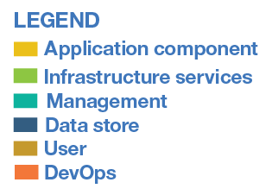






Solution Architecture
Client Scenarios
Solution Architecture
Delivery Framework
Testing Strategy
Sizing & Estimation
Delivery Model
Risk Reviews
Pricing Options
Integration with other offerings
Customize the Master Architecture Overview based on the Logical Components in solution scope
PUBLIC NETWORK
CLOUD NETWORK
ENTERPRISE NETWORK
Architecture Overview illustrates following aspects, typically included in any Cloud Application Development and DevOps on Cloud Solution
Multichannel Applications These can be manifested by Multichannel Digital Experience Apps integrating with supported APIs and Microservices for backend integration
Microservices These can be manifested using different development patterns & realized using a polyglot technology stack
API Runtime / Implementation implements functionality exposed by APIs. Can be implemented using different development patterns
Cloud Enabled Applications (Applications enabled to be deployed on virtual infrastructure)
Hybrid Cloud Integration provides a seamless platform for native or on-premises applications to interchangeably integrate end-to-end business-critical capabilities regardless of where these capabilities are deployed
Infrastructure includes Physical and Virtual Infrastructure, Bare Metal Servers, Storage, Network, Provisioning and Security Services
DevOps are critical to support core cloud native capabilities of CI/CD , release engineering as well as integrated monitoring & management of the solution (platform, middleware, applications)
CLOUD ENVIRONMENT
CONTAINER ENVIRONMENT
END USER
DIGITAL
EXPERIENCE
API
RUNTIME
MICROSERVICE
MICROSERVICE
CHANNELS
MICROSERVICE
MICROSERVICE
API GATEWAY
API
MANAGEMENT
MICROSERVICE
MICROSERVICE
ENTERPRISE
DATA
CLOUD INTEGRATION SERVICE
ENTERPRISE INTEGRATION SERVICE
Cloud Native Supporting Capabilities
IoT
DEVICES
Cloud Enabled Applications
SERVICES
MESH
CIRCUIT
BREAKER
SERVICE
DISCOVERY
ROUTING
SERVICES
TRACING &
LOGGING
MICROSERVICES
SECURITY
CONFIG
MGMT
Cloud Services
++
CLOUD ENABLED APPLICATION1
CLOUD ENABLED APPLICATION2
CLOUD
MESSAGING
TRANSFORMATION &
CONNECTIVITY
ENTERPRISE
MESSAGING
ENTERPRISE APPLICATION
DEVICES
AI ASSISTED
DATA INTEGRATION
DATA REPOSITORIES
AI
ANALYTICS
SECURITY
SERVICES
IoT
PLATFORM
EDGE
SERVICES
Container
Platform
INTERACTION APIs
SYSTEM APIs
ENTERPRISE
USER DIRECTORY
CONTAINER
ORCHESTRATION
CONTAINER
CLUSTER
MANAGEMENT
CONTAINER
SECURITY
LOAD
BALANCING
IMAGE
REPOSITORY
SERVERLESS
COMPUTING
BROWSER
Infrastructure
PHYSICAL
INFRASTRUCTURE
BARE METAL
SERVERS
VIRTUAL
INFRASTRUCTURE
STORAGE
NETWORK
PROVISION
INFRASTRUCTURE
SECURITY
EXTERNAL DATA
SOURCES
e.g. SOCIAL
DevOps
IBM Services for Cloud
CONTINUOUS
PROVISION
CONTINUOUS
BUILD
DEPENDENCY
MANAGEMENT
CONTINUOUS
TESTING
CONTINUOUS
DEPLOYMENT
MONITORING &
LOGGING
CLOUD
MANAGEMENT
SERVICES
6

Slide 7
Cloud Application Development with Solution Patterns
Client Scenarios
Solution Architecture
Delivery Framework
Testing Strategy
Sizing & Estimation
Delivery Model
Risk Reviews
Pricing Options
Integration with other offerings
Client scenario driven solution components for Cloud Application Development
Client needs to rapidly bring an innovative idea to market
Custom Cloud Application Development with chosen solution pattern
Distributed, Scalable, Fault tolerant and Independent services
Microservices Reference Architecture
Client wants build MVP in large-scale with full functional scope
Connectivity with systems of engagement, external partner and other enterprise systems
Client wants to re-write an existing application using new architecture and cloud native capabilities
API Reference Architecture
Re-engineered or Modernized Application with Cloud Native Architecture Style
Client wants to apply Cloud Native Transformation at Enterprise Scale
Modernized Integration Layer with connectivity to Enterprise Applications and Data
Integration enabled by Cloud Integration Services, Cloud Messaging and Interaction APIs
Client needs to modernize my Integration portfolio
Hybrid Cloud Integration
Note: Refer to Architecture Kit for further guidance on solution pattern options and decisions.
IBM Services for Cloud
7

Slide 8
Delivery Framework
Client Scenarios
Solution Architecture
Delivery Framework
Testing Strategy
Sizing & Estimation
Delivery Model
Risk Reviews
Pricing Options
Integration with other offerings
Identify the key Solution Components from Solution Architecture Overview
PUBLIC NETWORK
CLOUD NETWORK
ENTERPRISE NETWORK
Key Major Solution Components in the example Solution Architecture Overview are:
Multichannel Applications e.g. this solution requires UI Application to be developed.
Microservices
API Runtime / Implementation In this solution context, APIS can be interaction APIs for Hybrid Cloud Integration
Cloud Messaging in this example solution is used for Microservices Orchestration, Eventual Data Consistency and integration with enterprise systems e.g. leveraging Kafka Messaging.
DevOps are critical to support core cloud native capabilities of CI/CD , release engineering.
Note: Transformation & Connectivity between Cloud and Enterprise can be both ways. The Cloud Application will need integration with Enterprise Systems and On-Prem App/Enterprise System will have need to integrate with Cloud Applications.
CLOUD ENVIRONMENT
CONTAINER ENVIRONMENT
END USER
#3
#2
#1
DIGITAL
EXPERIENCE
API
RUNTIME
MICROSERVICE
MICROSERVICE
CHANNELS
MICROSERVICE
MICROSERVICE
API GATEWAY
API
MANAGEMENT
MICROSERVICE
MICROSERVICE
ENTERPRISE
DATA
CLOUD INTEGRATION SERVICE
ENTERPRISE INTEGRATION SERVICE
Cloud Native Supporting Capabilities
SERVICES
MESH
CIRCUIT
BREAKER
SERVICE
DISCOVERY
ROUTING
SERVICES
TRACING &
LOGGING
MICROSERVICES
SECURITY
CONFIG
MGMT
#4
CLOUD
MESSAGING
TRANSFORMATION &
CONNECTIVITY
ENTERPRISE
MESSAGING
ENTERPRISE APPLICATION
EDGE
SERVICES
Container
Platform
#3
INTERACTION APIs
SYSTEM APIs
ENTERPRISE
USER DIRECTORY
CONTAINER
ORCHESTRATION
CONTAINER
CLUSTER
MANAGEMENT
CONTAINER
SECURITY
LOAD
BALANCING
IMAGE
REPOSITORY
SERVERLESS
COMPUTING
BROWSER
Infrastructure
PHYSICAL
INFRASTRUCTURE
BARE METAL
SERVERS
VIRTUAL
INFRASTRUCTURE
STORAGE
NETWORK
PROVISION
INFRASTRUCTURE
SECURITY
#5
DevOps
IBM Services for Cloud
CONTINUOUS
BUILD
DEPENDENCY
MANAGEMENT
CONTINUOUS
TESTING
CONTINUOUS
DEPLOYMENT
MONITORING &
LOGGING
8

Slide 9
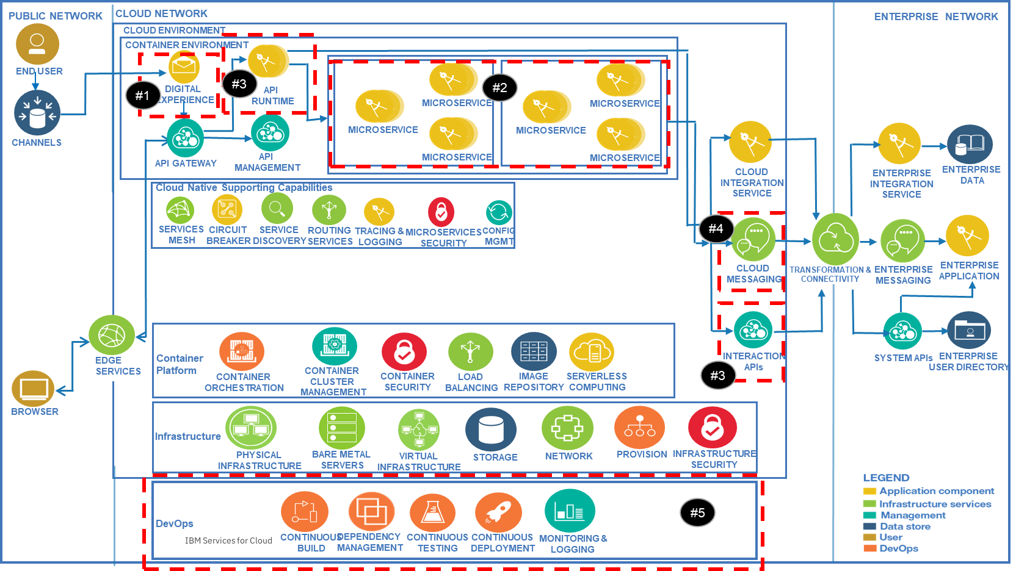
Delivery Framework
Client Scenarios
Solution Architecture
Delivery Framework
Testing Strategy
Sizing & Estimation
Delivery Model
Risk Reviews
Pricing Options
Integration with other offerings
Establish Overall Delivery Framework with solution phases and Application Workstreams (mapping to Soln Components)
Identify the Application workstreams that will deliver the solution components
Identify the continuous E2E Solution Delivery Activities e.g. E2E Requirement Analysis, E2E Solution Architecture and E2E Testing
Include Program and Technical Governance
E2E Governance
(Delivery+
Solution)
Program Governance
Technical Governance (Design Authority)
E2E
Solution Delivery
E2E Delivery
E2E Testing
E2E Solution Architecture
E2E Requirements Analysis
Application Workstream Delivery Teams
A. UI Applications
B. API
C. Micro-services
D. Integration
Platform Delivery
DevOps & Integrated Operations
Platform Architecture

Slide 10
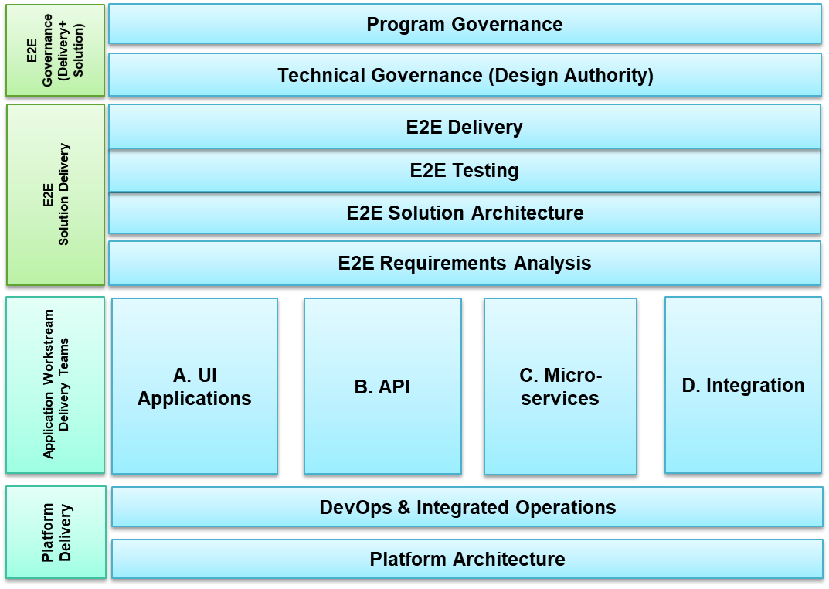
Sizing & Estimation
Client Scenarios
Solution Architecture
Delivery Framework
Testing Strategy
Sizing & Estimation
Delivery Model
Risk Reviews
Pricing Options
Integration with other offerings
Develop Estimation for Solution Components – User Interface
Component | Parameter | Small | Medium | Large
 |  | Value | Value | Value
UI (per screen / page) | Sections / Navigation / Popup | 1 to 2 | 3 to 5 | More than 5
 | Tabs | 1 to 2 | 3 to 5 | More than 5
 | Form fields/ Validation /Error Handling | 1 to 10 | 11 to 25 | More than 25
 | Screen complexity | free form tabular data | simple tabular data | nested tabular data
 | Workflow | None | Simple, 1 to 2 levels | Complex 1 to 2 levels
 | # API calls | 1 to 2 | 3 to 4 | More than 4
 | # business rules complexity | Simple | Medium | Complex
UI Estimation Model (attached workbook) provides:
Estimation for UI application based T Shirt Sizes (simple, medium and large)
Guidance on one time effort estimation
Total DCUT Effort estimation
UI Squad Productivity calculation
Use Workbook for the Effort Estimation
10

Slide 11
Sizing & Estimation
Client Scenarios
Solution Architecture
Delivery Framework
Testing Strategy
Sizing & Estimation
Delivery Model
Risk Reviews
Pricing Options
Integration with other offerings
Develop Estimation for Solution Components - APIs
Identify APIs and their Operations.
For Each factor, select the applicable complexity level (e.g. it is possible to have an API to have Complex # of endpoints and Simple Operations)
Award effort points per factor based on the last column. It is either same as the # for the factor or is a “weight” based on the applicable complexity
Total Effort points will be required to identify number of delivery squads
DCUT Efforts = Effort Points * 4 (Monolithic ) , Effort Points * 5.5 (Microservices)
Factors | Simple | Medium | Complex | Effort Point per Parameter
Number of endpoints/Services Invoked | 1 | 2 | 3 to 5 | Same as number of endpoints
No. of API Entities (e.g. Customer, Account) | 1 | 2 | 3-5 | 1,2,3
No. of API Operations (e.g. Get/Put/Post/Delete) | 1-4 | 5-8 | 9-20 | 1,2,3
API Data Models (Total no. of attributes) | <20 | 20 to 40 | 40-100 | 1,2,3
Data mapping complexity | 1 (Simple Proxy) | 2 (Aggregation of 1 Proxy & 1 new assembly) | 3 to 5 (Aggregation of 1-3 Proxy & 1-2 new API assembly) | Same as number of aggregations
Validation | None | Mandatory fields | >10 fields | 1,3
Error Handling | Standard Error codes | Custom Error codes | Framework | 1,2,3
Rules | None | Simple | Complex | 2,3
Security | None | Basic (Client id/Secret) | Custom/header based/OAuth | 2,3
Publishing APIs | 3 | 4-6 | 6-10 | 1,2,3
Subscription/Usage Management | Basic plan (<5 users) | Up to 3 Plans with rate limiting (<10 users) | >3 plans with rate limiting (>10 users) | 1,2,3
Use Workbook for the API Effort Point Calculation
Complexity | Effort points
Simple | 0 to 8
Medium | 9 to 21
Complex | 22 to 40 or above
11

Slide 12
Sizing & Estimation
Client Scenarios
Solution Architecture
Delivery Framework
Testing Strategy
Sizing & Estimation
Delivery Model
Risk Reviews
Pricing Options
Integration with other offerings
Develop Estimation for Solution Components - Microservices
Use Workbook for the Effort Estimation Example for “# of Squad” Calculation
Read through and use the guidance provided in the 'Guidance" tab in the estimation model (Excel Sheet) before working on the estimation.
Identify architectural patterns recommended for implementing an application based on a Microservices architecture
Based on the number of Microservices considered for each profile and in the "ServiceEffortsBFF", "ServiceEffortsBusiness" and "ServiceEffortsAdapter" tabs, the total DCUT efforts is automatically adjusted for BFF, Business and Adapter Microservices.
One Time effort is suggestive, add a multiplier example for Docker File and DevOps Pipeline based on discussion with AppOps Team
Note: For Refer to Microservices Infra Sizing Calculator for node sizing guidance.
12

Slide 13
Sizing & Estimation
Client Scenarios
Solution Architecture
Delivery Framework
Testing Strategy
Sizing & Estimation
Delivery Model
Risk Reviews
Pricing Options
Integration with other offerings
Develop Estimation for Solution Components - DevSecOps
Choose the DevSecOps solution option(s) that matches to the solution requirements
BYO hardware & license
IDENTIFY MICROSERVICE PATTERN
BYO Platform managed service
UC- 1
DevSecOps on Premise
IBM Professional Service for Platform
Custom toolchain
DEFINE & BUILD USE CASES
Professional Service for DevOps
Multi-tenant
Hosted on IBM Cloud
DevSecOps as a Service
Multi-tenant
UC- 2
IBM suggested toolchain
IDNETIFY SOLUTION APPROACH
Custom toolchain
Professional Service for DevOps
IBM suggested toolchain
Cloud Native
UC- 3
DevSecOps on Cloud of choice
Custom toolchain
Custom Tools
BUILD COST MODEL
Professional Service for DevOps
Hybrid
13

Slide 14
Sizing & Estimation
Client Scenarios
Solution Architecture
Delivery Framework
Testing Strategy
Sizing & Estimation
Delivery Model
Risk Reviews
Pricing Options
Integration with other offerings
Develop Estimation for DevSecOps solution - Leverage the Cost Model to estimate for DevSecOps solution on Premise
BYO hardware & license
Service | Cost Type | Low Complexity | Medium Complexity | High Complexity
DevOps Engineering Transformation services Scope includes Onboarding applications on CI/CD Pipeline and ongoing support to application teams. Cost covers 10 Deployment Units. Delivery of services using shared resources, no restrictions on delivery location This toolchain typically include Jira, Gitlab, Jenkins, Artifactory, UCD, SonarQube,, JFrog Xray, OWASP Zap | OTC (USD) AppOps Defined Toolchain | 6,932 | 10,816 | 20,189
 | SME Support (USD) | 4700 | 7300 | 11400
NOTE : In both use cases, it is assumed that Infrastructure (cloud environment/On-Premise Servers , license for tools be provided by client
(this covers Onboarding application on existing DevOps platform, does Not include Tools installation & integration)
With IBM Professional service for platform (SME Support)
UC- 1.1
BYO Platform managed service
DevSecOps on Premise
IBM Professional Service for Platform
Deployment Unit: Indicates a Microservice , which requires a Dedicated CI/CD pipeline and/or requires to be deployed separately to target deployment environment.
OTC : One Time Cost for designing/setting up CI/CD pipeline and configuration
The Toolchain included are based on some of Industry standard tools (Jira, Gitlab, Jenkins, Artifactory, UCD, SonarQube, JFrog Xray, OWASP Zap) adopted for CI/CD
OTC and SME Support shall vary based on additionall/separate tools, other than suggested above. This decision of toolchain and underlying infrastructure may be taken in design workshops
SME Support – This support starts after initial pipeline design -To manage /customize/support the existing pipelines for individual microservices – up to a period of 3 months
Custom toolchain
Professional Service for DevOps
Service | Cost Type | Low Complexity | Medium Complexity | High Complexity
DevOps Engineering Transformation Services Scope includes Onboarding applications on CI/CD Pipeline and ongoing support to application teams. Cost covers 10 Deployment Units. Delivery of services using shared resources, no restrictions on delivery location toolchain that typically include tools like Jira, Gitlab, Jenkins, Artifactory, UCD, SonarQube, JFrog Xray, OWASP Zap | OTC (USD) AppOps Defined Toolchain | 6,932 | 10,816 | 20,189
Without IBM Professional service for platform (no managing pipelines)
BYO hardware & license
UC- 1.2
BYO Platform managed service
DevSecOps on Premise
IBM Professional Service for Platform
Custom toolchain
Professional Service for DevOps
14

Slide 15


Sizing & Estimation
Client Scenarios
Solution Architecture
Delivery Framework
Testing Strategy
Sizing & Estimation
Delivery Model
Risk Reviews
Pricing Options
Integration with other offerings
Develop DevSecOps solution cost based on scenario given in the cost model (1/2)
SCENARIO
Design Pipelines On existing Toolchain
Manage pipelines
DevSecOps Squad & Roles
All costs are in USD
Service | Cost Type | Low Complexity | Medium Complexity | High Complexity
DevSecOps Engineering Transformation Service Scope includes Onboarding applications on CI/CD Pipeline and ongoing support to application teams. Cost covers 10 Deployment Units Cost covers upto 2 Design/build squad of medium complexity Delivery of services using shared resources, no restrictions on delivery location Cost is estimated based on toolchain that typically includes Jira, Gitlab, Jenkins, Artifactory, UCD, SonarQube, OWASP Zap, JFrog Xray | OTC for AppOps Defined Toolchain | 6,932 | 10,816 | 20,189
 | OTC for IBM Cloud DevOps Services | 5,282 | 8,962 | 18,099
 | SME Support upto 3 months | 4700 | 7300 | 11400
DevSecOps Toolchain as a Service (AppOps Shared Services Toolchain). Cost for tools including Jira, Gitlab, Jenkins, Artifactory, UCD. Standard configuration without customizations. Cost covering a team of upto 10 developers+Testers, 2 Build/deployment engineers. Toolchain access to IBMers accessing from IBM network, authenticated through W3id 99.5% Availability of DevOps tools | OTC | 639 | 639 | 639
 | SME Support (upto 3 months) | 2712 | 3252 | 3,795
DevSecOps Lead
DevSecOps Engineer (CD)
DevSecOps Engineer (CI)
DevSecOps Engineer (CD)
Shared Resource Pool
The Cost indicates the following role of the Squad
OTC – One Time Cost (does Not cover installation of tools and integration)
1 FTE of a DevSecOps Lead
2 FTE of DevSecOps Engineer
Can cover upto two Development/Build squads of medium complexity
SME Support consists of the following
2 FTE of DevSecOps Engineer (band may change)
Can support upto two Development /build Squads of medium complexity
OTC – Covers designing pipelines and integration of toolchain (include Jira, Gitlab, Jenkins, Artifactory, UCD, SonarQube, JFrog Xray, ) by required SME on standard set of toolchain.
Deployment Unit: A monolithic application, Or an application component, a microservice, an API, etc. which requires a dedicated CI/CD pipeline and/or requires to be deployed separately to target deployment environment.
DevOps toolchain as a service (AppOps Shared Services Toolchain): DevOps toolchain hosted on IBM Cloud, and managed by AppOps
15

Slide 16
Sizing & Estimation
Client Scenarios
Solution Architecture
Delivery Framework
Testing Strategy
Sizing & Estimation
Delivery Model
Risk Reviews
Pricing Options
Integration with other offerings
Develop DevSecOps solution cost based on scenario given in the cost model (2/2)
The following Squad are of OTC
1 FTE of DevSecOps Architect – To understand existing process, provide design Strategy, tools architecture , and verify/suggest toolchain and get approval. This activity is for a period of ~3 weeks
2 DevOps SME/Engineer – to install and configure tools ( as mentioned). Activity covers installation + Setup for end-to-end toolchain depending on fulfilment of pre-requisites (Network, access approval, third party/Client IT involvement)
Complexity Drivers for dedicated platform Setup are as follows-
Low – Stand Alone toolchain setup - 2 weeks
Medium – Single Site HA, Integration with On-Premise/Cloud Native tools - 4 weeks
High – HA, DR, Complex Security requirements -for ~6 weeks
This complexity is not determined through Rules defined in Slide #49 (complexity baseline. For estimation)
SCENARIO –
DevSecOps Design Strategy & Architecture
Install & Setup Toolchain On Premise
Design Pipelines & Support
Dedicated DevSecOps Squad & Roles (for Design Strategy for Toolchain, Install/Setup)
All costs are in USD
Service | Cost Type | Low Complexity | Medium Complexity | High Complexity
DevSecOps Discovery, Design Strategy & Architecture | OTC | 3130 | 4480 | 6720
Dedicated DevSecOps Platform setup (Toolchain typically includes Jira, Gitlab, Jenkins, Artifactory, UCD, SonarQube, OWASP Zap, JFrog Xray ) | OTC | 5150 | 10300 | 15450
DevSecOps SME Support Scope includes Onboarding applications on CI/CD Pipeline and ongoing support to application teams. Cost covers 10 Deployment Units. Delivery of services using shared resources, no restrictions on delivery location Toolchain that typically include tools like Jira, Gitlab, Jenkins, Artifactory, UCD, OWASP Zap, JFrog Xray | OTC for AppOps Defined/ Custom Toolchain | 6,932 | 10,816 | 20,189
 | OTC for IBM Cloud DevOps (if chosen ) | 5,282 | 8,962 | 18,099
 | SME Support (upto 3 months) | 4700 | 7300 | 11400
DevSecOps Architect
DevSecOps SME(tools)
DevSecOps Squad & Roles (design pipelines ,onboard applications & and SME Support)
The Cost indicates the following role of Squad (does Not cover installation of tools and integration)
OTC -
1 FTE of a DevSecOps Lead
2 FTE of DevSecOps Engineer
This squad supports upto 2 design/build squad of medium complexity
SME Support -
2 FTE of DevSecOps Engineer
Can Support across 2 Build squads
OTC – Covers designing pipelines and integration by required SME on standard set of toolchain.
This is for Either IBM DevOps Toolchain(on IBM Cloud) Or a Custom Toolchain as mentioned on left side box
DevSecOps Lead
DevSecOps Engineer (CI)
DevSecOps Engineer (CD)
Deployment Unit: A monolithic application, Or an application component, a microservice, an API, etc. which requires a dedicated CI/CD pipeline and/or requires to be deployed separately to target deployment environment.
AppOps Defined Toolchain Indicates standard toolchain that includes Jira, Jenkins, GitHub, SonarQube, Artifactory, UCD etc.
Shared Resource Pool
16
16

Slide 17
Sizing & Estimation
Client Scenarios
Solution Architecture
Delivery Framework
Testing Strategy
Sizing & Estimation
Delivery Model
Risk Reviews
Pricing Options
Integration with other offerings
Develop Estimation for DevSecOps Solution - Refer to Applicability Criteria & Excluded scenarios for the Cost Models
INCLUSIVE CRITERIA of T-Shirt Models | The following conditions should be met for applicability of the DevSecOps T-shirt model:
 | Standard technology stack: Java, .NET, C#, Node.js, AngularJS, etc.
 | Does not include package solutions like SAP, or MF / AS400 technologies
 | The t-shirt model applies only to application deployment. For other areas such as MW deployment or VM provisioning, please contact AppOps SMEs (AppOps Engagement Team/Poughkeepsie/IBM) for estimates.
 | No restrictions or specific requirements regarding DevOps tools to be used. AppOps defined DevOps instrumentation (Including AppOps Shared Services Toolchain)
 | DevOps SME Support is agnostic of delivery location and Support language and uses the AppOps Shared Service model
 | No service pertaining to CI/CD insights is required
 | Standard set of DevOps services
 | 8x5 Support window, with on-call support for business critical issues
EXCLUDED SCENRIOS | T-Shirt based Estimation Model does Not covers below scenarios:
 | Dedicated FTE based solution
 | Specific requirements regarding Delivery locations and support language
 | Container management, Docker Registry Management
 | Specific requirements, client preference, in tool selection criteria, Microclimate, IBM Cloud VPC, IBM Cloud DevOps tools
 | Mainframe DevOps, Database DevOps, Network Function Virtualization (NFV) DevOps
 | Infra as code (software defined environment)
 | DevOps solution for COTS applications (SAP, Oracle etc.), Analytics / Bigdata
 | Multi-Vendor scenarios for DevOps responsibilities
 | Custom specific scenarios or Estimates for achieving economies of scale
 | Services pertaining to CI/CD insights, DevOps telemetry
17

Slide 18
Sizing & Estimation
Client Scenarios
Solution Architecture
Delivery Framework
Testing Strategy
Sizing & Estimation
Delivery Model
Risk Reviews
Pricing Options
Integration with other offerings
Develop Estimation for DevSecOps Solution - Refer to Complexity baseline for Estimation/Cost Models
Sl.No. | Low Complexity | Medium Complex | High Complex
1 | Jira Agile project with no customization requirements, No integration with external tools | Jira Agile project with upto 2 workflow customization requirements, No integration with external tools | Jira Agile project with upto 3 workflow customization requirements, Integration with external tools
2 | Source code control using Single Gitlab repo, Upto 4 branches, Gitlab hosted along with other toolchain | Source code control using Single Gitlab repo, Upto 4 branches and requires upto 2 new branches every month, Gitlab hosted along with other toolchain | Source code control using Single Gitlab repo, Upto 4 branches and requires upto 4 new branches every month, Integration with external source code repo tools
3 | Standard build/packaging using Maven, Ant,NPM etc. Low complexity of build script automation. No frequent changes required in the Jenkins Build job. | Standard build/packaging using Maven, Ant,NPM etc. Medium complexity of build script automation. Requires change or support in analyzing each build jobs once every month. | Standard build/packaging using Maven, Ant,NPM etc. Build script automation includes packaging complex external dependencies. Requires change or support in analyzing each build jobs upto twice every month.
4 | Unit testing and code coverage as part of build job, Functional testing using Selenium web driver, No customization required for Sonar analysis (no custom rules) or integration | Unit testing and code coverage as part of build job, Functional testing using Selenium web driver, Minimum customization (rules) required for Sonar analysis or integration that doesn't exceed 8 hours of effort in setup | Unit testing and code coverage as part of build job, Functional testing using Selenium web driver, Customization (rules) required for Sonar analysis or integration that doesn't exceed 12 hours of effort in setup
5 | Standard Artifactory configuration with no remote repositories or no external dependencies stored | Artifactory configuration with remote repositories or external dependencies | Artifactory configuration with remote repositories or external dependencies
6 | Standard deployment upto 3 environments (dev, test, prod) using UCD | Standard deployment to 5 environments using UCD. | Standard deployment to 5 environments using UCD, involving target environments from multiple networks and using UCD Agent relay config.
7 | Doesn’t require building or deploying docker images, Doesn't require integration with Security scanning Build size doesn't exceed 500 MB size | Upto 5 build/deployments a week Build size doesn't exceed 1 GB size | 6 or more build/deployments a week Build size exceeds 1 GB size
8 | Requires Integration with Security scanning (Static Only) | Requires Integration with Security scanning (Static Only) | Integration with Security scanning (Static and Dynamic)
9 | Cloud Native applications based on technologies like Java, NodeJS, etc., Standard build/packaging using Maven, NPM, etc. | Low + Build and deployment of Microservices or Serverless components | Non-Cloud native technologies, Legacy applications, complex application or deployment architecture, Blockchain, Analytics, Database deployments, Bigdata
10 | Deployment to pre-configured Application runtimes (mostly immutable infra or PaaS) | Containerization using predefined docker files and base images and deployment to mutable infra like Kubernetes managed cloud environment | Medium + Defining Docker files and base images
11 | Release management, integration and management of docker registry are not in scope | Deployment steps include integration with Docker trusted registry services | Release management, integration and management of docker registry are in scope
18

Slide 19
Sizing & Estimation
Client Scenarios
Solution Architecture
Delivery Framework
Testing Strategy
Sizing & Estimation
Delivery Model
Risk Reviews
Pricing Options
Integration with other offerings
Develop Estimation for DevSecOps Solution - Infrastructure Sizing for Standard DevOps Tooling
The following table provides high level Infrastructure Sizing for Standard DevOps Tools (Standalone)
Sl. No | Tool | Typical HW sizing for a team of 50 Developers
1 | Jira | 4 CPU 8GB RAM 100GB Storage .
2 | Gitlab | 4 CPU 8GB RAM 100GB Storage.
3 | Jenkins Master | 4 CPU 8GB RAM 100GB Storage
4 | Jankins Slave | 8 CPU 16GB RAM 100GB Storage
5 | SonarQube | 4 CPU 8GB RAM 100GB Storage
6 | JFrog Artifactory | 4 CPU 8GB RAM 200GB Storage
7 | Jfrog Xray | 2 CPU 4GB RAM 50GB Storage
8 | UCD Server | 8 CPU 16GB RAM 80GB Storage
9 | DB Server for UCD | 4 CPU 16 GB RAM 100 GB Storage
10 | UCD License Server | 1 CPU 4 GB RAM 50 GB Storage
11 | OWASP ZAP | 1 CPU 2 GB RAM 500 MB Storage
19

Slide 20
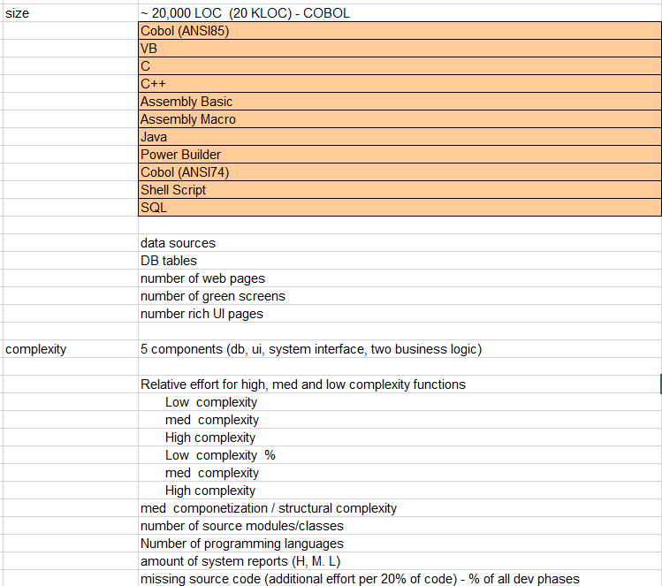
Sizing & Estimation
Client Scenarios
Solution Architecture
Delivery Framework
Testing Strategy
Sizing & Estimation
Delivery Model
Risk Reviews
Pricing Options
Integration with other offerings
Develop Estimation for Re-engineering Application Scenario
Leverage Application Reengineering / Re Write - Estimation Technique that provides guidance on:
Step-by-step instructions to use and customize the Estimation Model
Assistance with Rules of Thumb for missing inputs
Definitions for Errors and Warnings generated by the Estimation Model along with advice on how to resolve
Guidance for creating the role durations and project schedule
Pointers to reference materials and other estimation models for anything that is out of scope for the Estimation Model
Guidance while customizing the SOW template
Use Workbook for the Application Reengineering / Re Write Effort Estimation
20

Slide 21
Sizing & Estimation
Client Scenarios
Solution Architecture
Delivery Framework
Testing Strategy
Sizing & Estimation
Delivery Model
Risk Reviews
Pricing Options
Integration with other offerings
Estimation Model Summary and guidance for effort distribution across various solution delivery phases
Application Pattern/ Solution Component | Estimation Model Approach
API | Simple, Medium and Complex complexity profile driven estimation Complexity Parameter values drive effort point estimation that is extrapolated to DCUT effort hours
Microservices | Configurable Complexity Profile definition driven estimation Complexity Profile Parameter values drive DCUT effort hours
User Interface | T-Shirt (Small, Medium and Large) size driven estimation T-Shirt Size Parameter values drive DCUT effort hours
DevSecOps | Simple, Medium and Complex complexity profile driven estimation Complexity Parameter values drive the cost of DevSecOps services
Solution Phases/Components, Governance & Contingency
Agile | % age distribution of Total Effort | Waterfall | % age distribution of Total Effort
Solution Delivery + Deploy + Feedback Optimize (Sprint 1..N) | From Estimates | Total DCUT Hours | From Estimates
Solution Outline + Macro (SOM) | 70% of DCUT | Solution Outline + Macro (SOM) | 70% of DCUT
DevOps | 15% of DCUT | DevOps | 15% of DCUT
Test Support by Development Team (Defect fixing etc.) | 10% of DCUT | Test Support | 10% of DCUT
Continuous testing (Sprint 1..N) for SIT | 15% of (DCUT + SOM) | SIT | 15% of (DCUT + SOM)
Continuous testing (Sprint 1..N) for UAT | 15% of (DCUT + SOM) | UAT | 15% of (DCUT + SOM)
Total Effort | SUM of all above | Total Efforts | SUM of all above
Program Management + Sprint Planning (Sprint 1..N) | 10% of Total | Project Management | 10% of Total
Contingency | 15 | Contingency | 10
Note: Estimations may vary for different cloud providers and platforms
21

Slide 22




Delivery Model
Client Scenarios
Solution Architecture
Delivery Framework
Testing Strategy
Sizing & Estimation
Delivery Model
Risk Reviews
Pricing Options
Integration with other offerings
Develop Delivery Model using Co-creation and Governance
Project Delivery Team
Governance Team
(Program / Design Authority)
Delivery Core / Leadership Squad
Client Squad Members
(Shared Ownership)
Product
Owner
Program
Leader
Lead
Architect
Lead
BA
DevOps
Lead
Lead
Architect
(offshore)
Client Product Owner responsible for the vision, requirements, owns the backlog prioritization, and final acceptance
Product Owner
Optional Roles:
Scrum Master /
Squad Leader
Security Architect
Client Business Analysts work very closely with IBM Business Analyst to define user stories and the “Definition of done”
UX Squad 1
UI Squad 1
Cloud Platform
Architect
Business Analyst
UI Squad 2
Business Analyst
Client App SMEs will support faster navigation of current code and easier extraction of reusable code
API Squad
Bus Services Squad 1
UI Developer
App
SMEs
Microservices
Developer
Application SMEs /
Developers
Bus Services Squad 2
Client Test Engineers will help by identifying and distributing reusable Test suites, test cases and baselined Test data for regression testing
Adapter Interface Squad
Performance
Engineer
Workflow
Engineer
Quality Engineer
Platform Engineering Squad
Quality Engineer /
QA
E2E Integration & Testing Squad
IBM
Note: Squads are built based on co-creation model to ensure success. Governance squad and client participation is critical to success
Client
Client Infrastructure & Support
Client Business Users
IBM or Client
Co-creation model – eliminates barriers and reduces risks to the program
22

Slide 23
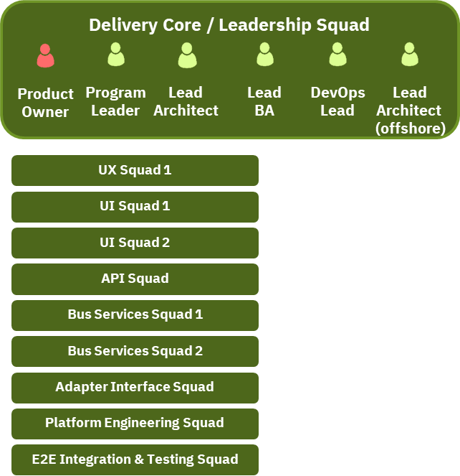








Delivery Model
Client Scenarios
Solution Architecture
Delivery Framework
Testing Strategy
Sizing & Estimation
Delivery Model
Risk Reviews
Pricing Options
Integration with other offerings
Refer to guidance for structuring Delivery Core/Leadership Squad and proposed roles & responsibility
Client Product Owner/Product Manager is responsible for the vision, requirements, owns the backlog prioritization, and final acceptance
Lead Business Analyst
Understand Functional Context
Capture functional requirements
Define, document and get agreement on Acceptance Criteria
Optional Roles:
Program Leader
Ownership of customer requirements
Ownership of billing and consumption models
Manage Release Versions and Releases
DevOps Lead
Participates in design discussion for CI/CD
Tracks pipelines progress for CI/CD
Guides DevOps Engineers
Determines Pipeline Dashboarding, image lifecycle policy etc.
Security Architect
Cloud Platform
Architect
IBM Roles
Client Roles
IBM or Client Roles
Lead Architect / Design Authority
Understand overall context
Define Application Architecture
Make Technology Selection
Lead Architect (Offshore)
Review Architecture and Approach
Review Decisions
Critical Sit Support through Global Connect
Program Leader
Security Architect
Lead Security Solution Design based on risk & compliance requirements
Provide subject matter expertise and security
services execution oversight
Integrate security processes and technology
efforts in-line with business objectives
Cloud Platform Architect
Lead architecture and design of cloud platform
Define Deployment and Operation Architecture
Create Bill of Material of software and infrastructure solution components
Review the DevOps and Operational tooling design
Product Owner
Lead Architect
Lead BA
DevOps Lead
Lead Architect (Offshore)
23

Slide 24
Delivery Model
Client Scenarios
Solution Architecture
Delivery Framework
Testing Strategy
Sizing & Estimation
Delivery Model
Risk Reviews
Pricing Options
Integration with other offerings
Refer to guidance for structuring UX Squad and proposed roles & responsibility
Design Thinking Coach
Chair and conduct Design Thinking Workshops
Summarize Workshop Outcome e.g. Empathy Map, Hills, User Journeys, MVP definition etc..
Present the Workshop Outcome with stakeholders and take feedback for next steps
UI Developer
Develop the UI/BFF
Implement the UI Flow
Integrate to the backend interfaces
IBM Roles
Experience Designer
Design the User Experience
Design quick versions of UI Look and Feel with navigation
Guide the UI Wireframe Design
Client Roles
UI Designer
Design the Wireframes
Design the UI Navigation
Design the Backend Interface Points
Design Thinking Coach
Lead BA
UI
Designer
UI Developer
24

Slide 25
Delivery Model
Client Scenarios
Solution Architecture
Delivery Framework
Testing Strategy
Sizing & Estimation
Delivery Model
Risk Reviews
Pricing Options
Integration with other offerings
Refer to guidance for structuring UI Squad and proposed roles & responsibility
Client Product Owner/Product Manager is responsible for the vision, requirements, owns the backlog prioritization, and final acceptance
Business Analyst
Understand Functional Context
Capture functional requirements
Define, document and get agreement on Acceptance Criteria
Quality Engineer
Identify Main and Alternate Scenarios for Functional testing
Author test cases
Execute Test Cases
Execute A/B & Canary Testing
IBM Roles
App SME / Developer
Client App SMEs will support faster navigation of current code and easier extraction of reusable code
Client Roles
UI Designer
Design the Wireframes
Design the UI Navigation
Design the Backend Interface Points
UI Developer
Develop the UI/BFF
Implement the UI Flow
Integrate to the backend interfaces
Product Owner
Business Analyst
UI Designer
App SME / Developer
UI Developer
UI Developer
Quality Engineer
25

Slide 26
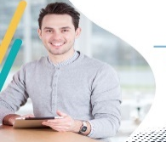
Delivery Model
Client Scenarios
Solution Architecture
Delivery Framework
Testing Strategy
Sizing & Estimation
Delivery Model
Risk Reviews
Pricing Options
Integration with other offerings
Refer to guidance for structuring API Squad and proposed roles & responsibility
Client Product Owner/Product Manager is responsible for the vision, requirements, owns the backlog prioritization, and final acceptance
Client Business Analysts work very closely with IBM Business Analyst to define user stories and the “Definition of done”
App SME / Developer
Client App SMEs will support faster navigation of current code and easier extraction of reusable code
Quality Engineer
Identify Main and Alternate Scenarios for Functional testing
Author test cases
Execute Test Cases
Execute A/B & Canary Testing
IBM Roles
Client Test Engineers will help by identifying and distributing reusable Test suites, test cases and baselined Test data for regression testing
API Designer
Identify APIs
Define API Interfaces
Specify API Payload
Design Security Solution
Design API Monitoring and Performance Management
Define API Consumption and Plans
Client Roles
API Developer
Create and configure APIs
Reuse assets and apply patterns
Technical implementation of APIs
Unit Test
Product Owner
API Designer
Business Analyst
API Developers
App SME/ Developer
Quality Engineer
Quality Engineer
26

Slide 27
Delivery Model
Client Scenarios
Solution Architecture
Delivery Framework
Testing Strategy
Sizing & Estimation
Delivery Model
Risk Reviews
Pricing Options
Integration with other offerings
Refer to guidance for structuring Microservices Squad and proposed roles & responsibility
Client Product Owner/Product Manager is responsible for the vision, requirements, owns the backlog prioritization, and final acceptance
Client Business Analysts work very closely with IBM Business Analyst to define user stories and the “Definition of done”
App SME / Developer
Client App SMEs will support faster navigation of current code and easier extraction of reusable code
Quality Engineer
Identify Main and Alternate Scenarios for Functional testing
Author test cases
Execute Test Cases
Execute A/B & Canary Testing
Client Test Engineers will help by identifying and distributing reusable Test suites, test cases and baselined Test data for regression testing
Microservices Designer
Designer / Specification Specialist
What is the bounded context?
What is/are the core functions exposed by Microservice App?
What is the business logic required for implementation
Business Squad, Design Squad
IBM Roles
Client Roles
Microsevices Developer
Create and configure APIs
Reuse assets and apply patterns
Technical implementation of APIs
Unit Test
Product Owner
µService Designer
Business Analyst
µService Developers
App SME/ Developer
Quality Engineer
Quality Engineer
27

Slide 28
Delivery Model
Client Scenarios
Solution Architecture
Delivery Framework
Testing Strategy
Sizing & Estimation
Delivery Model
Risk Reviews
Pricing Options
Integration with other offerings
Refer to guidance for structuring Platform Engineering (DevOps) Squad and proposed roles & responsibility
DevSecOps Lead
Participates in design discussion for CI/CD Tracks pipelines progress for CI/CD
Guides DevOps Engineers
Determines Pipeline Dash-boarding, image lifecycle policy etc.
IBM Roles
Client Roles
DevSecOps Engineer (CI)
Builds Pipelines for (CI) Continuous Integration
Application specific DevOps Scripting
DevSecOps Engineer (CD)
Designs Deployment orchestration
Automated Environment Configuration through DevOps
DevSecOps Lead
DevSecOps Engineer (CI)
DevSecOps Engineer (CD)
28

Slide 29
Delivery Model
Client Scenarios
Solution Architecture
Delivery Framework
Testing Strategy
Sizing & Estimation
Delivery Model
Risk Reviews
Pricing Options
Integration with other offerings
Refer to guidance for structuring E2E Integration & Testing Squad and proposed roles & responsibility
Test Lead
Define Test Approach
Design the Test cases
Define the Test entry and exit criteria
Create Quality Reports
Client Test Engineers will help by identifying and distributing reusable Test suites, test cases and baselined Test data for regression testing
Quality Engineer (Automated Testing)
Identify test cases for automation
Create and Test Automation Scripts
Integrate with devops
Execute Tests
Automate A/B & Canary Testing
Quality Engineer
Identify Main and Alternate Scenarios for Functional testing
Author test cases
Execute Test Cases
Execute A/B & Canary Testing
IBM Roles
Client Roles
Security Quality Engineer
Identify Main and Alternate Scenarios for Security Testing
Vulnerability & Penetration testing
Quality Engineer (Performance)
Identify testing Scenarios for Performance testing
Author test cases
Execute Test Cases
Create the Performance Test Report
Test Lead
Quality Engineer
Client Test Engineer
Quality Engineer (Automated Testing)
Quality Engineer (Performance)
Quality Engineer (Security)
29

Slide 30
Delivery Model
Client Scenarios
Solution Architecture
Delivery Framework
Testing Strategy
Sizing & Estimation
Delivery Model
Risk Reviews
Pricing Options
Integration with other offerings
Example Cloud Application Development Team Composition
One Squad
One Squad
Multiple UI Squads
Workstream Technical & Delivery Governance
Architecture Guild
UI Squad
Program Manager
Application Architect
DevOps Lead
Lead Business Analyst
SRE
API Product Manager
Scrum of Scrum Execution, Risk, Activity Tracking
Project Financial Management
Application Architecture & Viability
Architecture Guild Leadership
Business Requirements Governance
Solution Architect
Application Architect
Security Architect
Data Analyst
Technical Consultant
Microservice/API Designer
Cloud Platform Architect
Architecture Spike Identification with E2E Arch Team
PoC/PoT Implementation
Publish / Update Implementation Practices, Technique Papers
Develop Assets
Design Microservices and API Security
UX Architect
Business Analyst
BFF Developer
BFF Developer
BFF Developer
Quality Engineer
UX Architecture
UI Design
BFF Implementation
Integration
Security
Iterative Usability Review
Domain n
Teams can follow CoSquad or Squad Model
Domain 2
4 to 5 Squads per engagement
CoSquad Model
Squad Model
Domain 1
All the members are either “onshore” or “offshore”
No split teams across locations
Absolute clarity on backlog for minimum 2 sprints for offshore CoSquad to be assembled
Exception:
Design thinking SME/ visual designer and Complex Solution Architects could be closer to client
Squads formed with globally dispersed individuals and “collaborate” well
Virtually behave as one team: tool-based work allocation, and management (Murals, JIRA, DevOps pipeline, and so on)
Program Manager/Scrum Master, Complex Solution Architect, visual designer, and Developer are key roles that need to be closer to client
Clear set of collaboration tools planned and budgeted in the deal
Domain Squad (s)
Design Build Squad (s)
Identify and Design Microservices
Design and Develop APIs
Plan the sprints for microservices development and maintain the backlogs
Develop Microservices with Red Hat Cloud
Automated Unit & Functional Testing @ Story Level (done by Dev Team)
Test Automation for integration testing
Cloud Platform DevOps toolchain
Domain Lead
Domain SME1
Domain SME2
…….
Product Manager
Scrum Master
API/Microservices Designer
API/Microservices Developer
DevOps SME
Functional Tester
Cloud Platform App SME
Cloud Platform App Developer
One Squad per Design Build Squad
One Squad
Quality Engineering Squad
Ops Squad(s)
Program Manager
Testers
Functional Tester
Automation Tester
Security Tester
Plan for functional testing
Create test packs
Publish test results
Develop automation scripts
Implement regression with DevOps
Cloud Platform DevOps Lead
Cloud Admin
Ops “Instrumentation” during design-build
Platform Design & Engineering
30

Slide 31

Delivery Model
Client Scenarios
Solution Architecture
Delivery Framework
Testing Strategy
Sizing & Estimation
Delivery Model
Risk Reviews
Pricing Options
Integration with other offerings
Refer to guidance for structuring Application Re-engineering Roles & Responsibilities
Program Leader
Ownership of customer requirements
Ownership of billing and consumption models
Manage Release Versions and Releases
Client Product Owner/Product Manager is responsible for the vision, requirements, owns the backlog prioritization, and final acceptance
Cloud Modernization Consultant
Manage, craft, and steer project deliverables towards meeting end state modernization goals
Lead Application Modernization with tool based current state static analysis,
Apply modernization methods, approaches, patterns, tool accelerators, current state analytics modeling, enrichment, business rules extraction method, process, and techniques
Experienced in Legacy technologies e.g. Mainframe, Cobol, CICs, IMS DB, JCL and IBMI (RPG, DB2/I, Synon) etc..
Develop transition state and end state modernization architectures across multiple modernization outcomes such as package replacement/migration and rewrite/re-engineer
Application Developer- Current State
Analyze the clients current state application
Experienced in the clients current state technologies (mainframe, Cobol, IMS transaction processing, IMS Database, DB2, JCL)
Experience using static code analysis ideally with ADDI and business rules extraction ideally using RAA
Application Developer- Current State
Apply tool based methods and accelerators for application modernization such as the modernization fabric and/or current state analytics modeling and enrichment
Load and validate the current state application inventory into ADDI
Install and Configure business rules extraction
Experienced in Legacy technologies e.g. Mainframe, Cobol, CICs, IMS DB, JCL and IBMI (RPG, DB2/I, Synon) etc..
Modernization Architect – Integration
Develop integration architectures across multiple platforms, ideally between mainframes and distributed platforms and packaged software solutions
Develop coexistence architectures between current state applications and modernized applications n an incremental role out scenario
Develop data replication (CDC based solutions), API architectures, using of message brokers
Assist in developing the transition state and end state architecture for the client solution
Application Developer– Integration
Implement integration architectures across multiple platforms, ideally between mainframes and distributed platforms and packaged software solutions
Implement coexistence architectures between current state applications and modernized applications n an incremental role out scenario
Implement data replication (CDC based solutions), API architectures, using of message brokers
Assist in developing the transition state and end state architecture for the client solution
Application Architect - Data Modeler
Design and develop the modernized data model including distribute domain based Microservices orientated data models
Lead a team of Data Modelers in designing the modernized data model
Assist in developing current state data model knowledge, coexistence integration models and data & interface mapping
Application Developer- Data Modeler
Design and developing the modernized data model under the leadership of the Data Architect
Assist in developing current state data model knowledge, coexistence integration models and data & interface mapping
IBM Roles
Application Developer- DBA
Develop deploy, and test (unit testing) the modernized data model
Supplement to the client DBA to manage bandwidth for large modernization efforts
Client Roles
31

Slide 32













Delivery Model
Client Scenarios
Solution Architecture
Delivery Framework
Testing Strategy
Sizing & Estimation
Delivery Model
Risk Reviews
Pricing Options
Integration with other offerings
Refer to guidance for structuring Application Re-engineering Roles & Responsibilities contd.
Application Architect - Data Migration
Design and develop the data migration solution
Assist developing the solution and syncing / sharing design efforts with the coexistence solution
Application Architect - Target State
Lead designing and developing the modernized target solution
Shares leadership responsibilities with the Cloud Modernization Consultant
Current State App SME
Possess knowledge of the current state application
Support access to data models and schema's as well as system level usage information on the current state
Application Developer - Target State
design and develop the modernized target solution under the leadership of Application Architect - Target State
highly skilled in the target state application technologies e.g. Cloud Native Applications, APIs, Microeservices etc.
Application Architect - BI / Big Data
Lead design and development of the business intelligence / big data supporting architect and solution (When part of a modernization overall scope)
Lead conversion, update, redesign / re-architect of current state reporting solutions
Target State App SME
(for package solutions)
Possess knowledge of the current state application
Support access to data models and schema's as well as system level usage information on the current state
Application Developer - BI / Big Data
designing / developing the BI / Big data solution
Convert, update, redesign / re-architect of current state reporting solutions
Test Architect
Plan, design, and develop the overall test strategy, test plan, and test scripts for the overall modernization effort
Manage and guide the overall testing effort
Lead the team of Quality Engineers for the complete end to end testing effort through system, integration, performance, UAT, and deployment testing phases
Business Analyst
Analyze the current state business processes
Develop the modernized (to be) business processes to guide the modernized solution requirements
Industry Consultant
Help to align the modernized solution to take advantage of the latest in technologies and strategies for the particular client industry
Experience Designer
Design the User Experience
Design quick versions of UI Look and Feel with navigation
Guide the UI Wireframe Design
IBM Roles
Client Roles
UI Developer
Develop the UI/BFF
Implement the UI Flow
Integrate to the backend interfaces
Quality Engineer
Develop detailed design and execution of test scripts for all phases of testing
Conduct testing, document testing results and defect
32

Slide 33
Delivery Model
Client Scenarios
Solution Architecture
Delivery Framework
Testing Strategy
Sizing & Estimation
Delivery Model
Risk Reviews
Pricing Options
Integration with other offerings
Develop WBS for New Cloud Application Development (Microservices Pattern) based on reference High level Workflow
|
Customer & IBM Squad co-create and shape abstract idea through user stories and prototype to define first MVP
Prototype
Design Thinking Workshops
Prototype
On Paper MVP
Architecture
User Stories for new application are identified. IBM Squad co-creates solution blueprint and realizes model implementation for scenarios along with E2E plan & MVP
Playbacks
Blueprint
Prioritized Backlog
High Level Design
Architecture / HL Design
Dev Env & Tools
Ref Implementation
Demo
Sprint Planning & Delivery Model
Micriservices & API Specification
Multiple Realization Squads governed through arch guild realize user stories in an iterative manner.
Co-creation through playbacks, & continuous E2E tests for acceptance
Analyze &
Design
Stories - MVP
Demo
Data Model & Test Cased
Platform, DevOps Tool Specification
Build & Deploy
User Stories - MVP
Demo
User Stories - MVP
Demo
Demo
User Stories - MVP
Project Playback
Deployed to Production
Ops & Realization Squads collaborate with customer for production release
Run & Manage
Production Readiness Test
Ops Tool Configuration
Onboard Apps
Prototype
Blueprint
Analyze & Design
Build & Deploy
Manage Apps
Activities
Setup Dev & Test Environments
Realize Microservice
Realize Ops Procedures
Daily Scrum Calls
Conduct Playbacks
Backlog Refinement and Reprioritization
Conduct E2E Testing
Run & Manage
Activities
- Design Thinking
- Develop Prototype
- Define MVP
Activities
- Discover Source Systems
- Just Enough Architecture
- Setup Dev Environment
- Realize Significant Scenarios (Skeleton)
- Identify Bounded Contexts & Workflows
- Create Sprint Plan
Activities
- Identify & Design Microservices
- Define Data Model
- Design Platform
- Design DevOps
- Define Tests
Activities
Operationalize Integrated Management
Verify Production Readiness for application (incl. Security & Resiliency)
Verify Production Readiness for Ops Setup (E2E Ops)
Onboard Application for Run-Manage
Outcomes
- Design & User Experience Principles
- Representative full User Stories
Prototype
- Initial story catalog
Outcomes
- Microservices catalog
- API Specification
- Data Models
- Platform & Tool Specifications
- DevOps Specifications (incl. Ops Squad model)
- Test Cases
Outcomes
- Refined catalog & prioritized backlog
- Architecture Foundation
- Dev Environments & Tools
- Reference Implementation for significant scenarios
- Bounded Contexts & workflows
- Sprint Plan incl. Delivery Model
Outcomes
- Dev & Test Environments
- Realized Microservices
- Tests
- Management Procedures
Outcomes
- Production readiness tests
- Ops Tools & configuration
33

Slide 34
Delivery Model
Client Scenarios
Solution Architecture
Delivery Framework
Testing Strategy
Sizing & Estimation
Delivery Model
Risk Reviews
Pricing Options
Integration with other offerings
Develop WBS for Reengineer to Cloud Native Application / Microservices based on reference Workflow
|
Deep Modernization Discovery
Current State & Discovery Env
Discovery & Current State Establishment
Business and IT Solution Strategy
Analysis
Application Analysis
Modernization Approach
Blueprint
Business Solution
Application, Platform & Security Architecture
Initial Plan & Roadmap
Test Strategy & Approach
MVP Backlog
DevOps Approach
PoV / MVP1
PoV Sprint Plan
PoV Target Env
DevOps Platform & Tooling
PoV Build
Refine Architecture
Component Testing
Modernization Increment Planning
Estimate, Staffing & Onboarding
Sprint & Production Release Plan
Incremental Modernization
Incremental Modernization
Incremental Modernization
Incremental Modernization
E2E Testing & Deploy to Production
E2E Testing
Ops Acceptance
Prod Deployment
Modn. Discovery
Analysis
Blueprint
PoV/MVP1
Increment Planning
Increment Modernization
E2E Testing & Prod Deployment
Activities
Capture Current State Environment
Establish Discovery Environment
Establish Current State Application Repository
Document Current State Application
Develop Business and IT Solution Strategy
Activities
Analyze application
Determine Modernization approach
Activities
Develop Business Solution
Develop User Experience & UI Designs
Develop application, Platform and Security architecture
Define Initial Plan & Roadmap
Define Test Strategy & Approach
Define MVP Backlog
Define DevOps approach
Activities
Develop PoV Sprint Plan and Target Env
Establish DevOps Platform & Tooling
Implement Significant scenarios
Refine technical architecture
Conduct component level tests
Activities
Refine estimates
Define Sprint Plan
Delivery staffing and onboarding
Deployment and production plan release planning
Activities
Define user stories
Refine development environment & DevOps
Design and build user experience, business logic components, integration and coexistence, data
Refine technical architecture
Conduct component level tests
Activities
Conduct functional tests
Conduct performance and scalability tests
Conduct security tests
Operational acceptance
Production deployment/promotion
Deliverables
Current State
Application, Data and Infra Inventory
Business function, App & Data relationships
Deliverables
Modernization Approach
Assumptions, Security Requirements
Deliverables
Business & Technical dependency Map
Co-existence Architecture
Target cloud-native application architecture
Deliverables
Exécutables Code, Unit Tests
Apps / Deployable
Data Migration
CI/CD Pipelines
Component Test cases
Deliverables
Detail design for target state
Modernization Milestone Plan and Increments
Deliverables
Exécutables Code, Unit Tests
Apps / Deployable
Data Migration
CI/CD Pipelines
Component Test cases
Deliverables
Functional, Performance and Security Test cases
User Acceptance Test cases
Production Deployable
Operational Acceptance
34

Slide 35
Delivery Model
Client Scenarios
Solution Architecture
Delivery Framework
Testing Strategy
Sizing & Estimation
Delivery Model
Risk Reviews
Pricing Options
Integration with other offerings
Develop End to End Responsibility Matrix
Identify responsibilities between Platforms, Applications and Operations as sample below for inputs to develop the RACI
Application Code Implementation and Microservices
Packaged Solutions
Node
Java
ACE
Kafka
APIC
WAS Liberty
Istio
Micro-climate
Redis DB
BPM
Cognos
IIS
Content Foundation
Rational Tools
MySQl
DevSecOps
Application Operation
Platform as a Service
Container as a Service
Cloud Container Platform
VM and Guest OS
Devices (Connected Devices)
Platform: Installation
Platform: Management
Runtimes & Middleware Installation & Mgmt.
VM, Guest OS : Installation and Mgmt.
Application Development & Mgmt.
DevSecOps
App Operation
Packaged Solutions
Devices
Typical Owner / Alternatives:
IBM Product Support
Cloud Provider
Client
GTS (ICDS)
Image Inbuilt
Cloud Provider
AppOps for OTT
Client Vendor
Cloud Provider
GTS (IMI)
GBS
Client Development Team
AppOps
Client Engg. Team
AppOps
GBS
Client
GBS
Third Party
35

Slide 36
Delivery Model
Client Scenarios
Solution Architecture
Delivery Framework
Testing Strategy
Sizing & Estimation
Delivery Model
Risk Reviews
Pricing Options
Integration with other offerings
Develop RACI for the client solution:
Use sample RACI to develop solution specific RACI
Activities | IBM | Client
Blueprint & Planning
Finalize the Requirements & Backlog | A,R | C
Provide requirements | I,C | A,R
Review and Approve the requirements (in terms of details and completeness) | A,R | I, C
Define Target Architecture | A,R | C
Define Plan | A,R | C
Define the data to be migrated | R | A,C
Define the Canonical Message Model | A,R | C
Review and approve Blueprint Deliverables | I | A,R
Review and approve the final estimates and plan | C | A,R
Finalize the user requirements, Definition of done, task list and allocation | A,R | C
Define the UI wireframes | A,R | C
Define the API Specifications | A,R | C
Define the ETL interfaces | A,R | C
Define the Event Streams | A,R | C
Dev Environment ready | A,R | C
Initial Sync - connect all layers in the Architecture in Dev | A,R | I
Build
Prioritize the User Stories for each squad | A,R | C
Finalize Plans for each squad | A,R | I
Build & Unit Test (SPA, business services, data services, Data Stores, Event streams) | A,R | I
Create Application Test Suite | A,R | C
Create Performance Test Suite | A,R | C
Prepare Test Data & deliver for interim build test and final testing | I | A,R
Activities | IBM | Client
Security
Security architecture and compliance | A,R | C
Integrate
Integrate and harden end to end application | A,R | I
Deploy to Test Environment | A,R | C
Perform Integration Testing | A,R | C
Complete System Integration | A,R | C
QA Environment Ready | A,R | C
Testing
Deploy to QA environment | A,R | C
Perform Functional & System Integration Testing | A, R | C
UAT/ Performance Testing
Deploy to UAT & Performance Testing environments | A,R | I
Conduct Performance Testing | A,R | I
Finalize Test Cases for UAT | A,R | I
Conduct UAT | A,R | I
Production environment Ready | A,R | I
Deploy
Production Readiness Review | A,R | I
Deploy to Production | A,R | I
Go Live | A,R | I
Run & Manage
Decommission | A,R | I
Warranty
Warranty Support | A,R | I
Handover Complete | R | A,C,I
Detailed RACI template can be found in Reference section
36

Slide 37

Case Study
London Market Target Operating Model
Common Infrastructure Services
Delivering key technical standards and critical supporting services identified as common cross-project requirements to support secure data sharing and integration goals for the LM TOM.

Slide 38
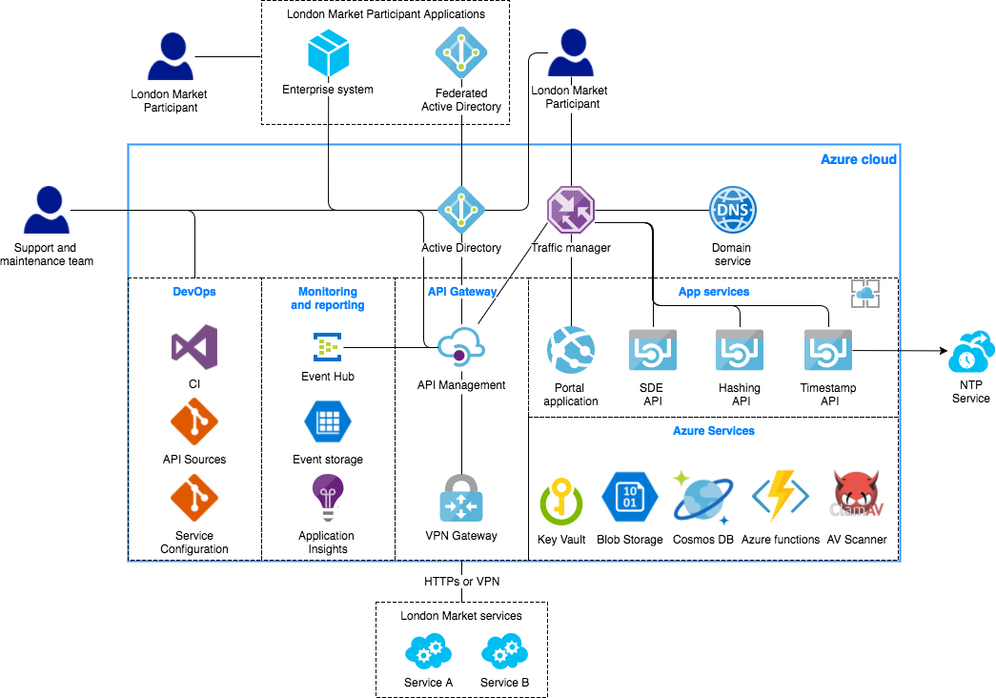
Case Study – Common Services AOD

Slide 39
Case Study – Common Services Estimating approach
 | Small / Prototype | Medium
Number of Microservices | 1-5 | 6-20
Typical Complexity Distribution (Simple:Medium:Complex) | 60:20:10 | 40:40:20
Microservices Business API and Persistence | <= 2 Entities | <= 4 Entities
 | <= 20 Fields / Entity | <= 20-40 Fields / Entity
 | <=4 operations | <=8 operations
 | Standard Error Codes | Standard + Custom Error Codes
 | Simple Business Logic | Medium Business Logic ; 5-10 rules
Microservice Application: ETL | One to One Mapping for 2 Entities, up to 20 fields / Entity | One-Many OR Many-One mapping for 4 entities, 20-40 fields/entity
 | No Validation | Validation for Mandatory fields only
Microservice Application: IPC | No external integrations | <= 2 external integrations
 |  | Synch OR Asynch communication
 |  | REST or SOAP
API Management Scope | No API Management Required | Required - Up to 3 plans with rate limiting
DCUT Effort | ~250 (80 -420) | ~2145 (990 – 3300)
Lifecycle Effort | ~625 (200 – 1050) | ~5400 (2500 – 8300)

